Slide 1
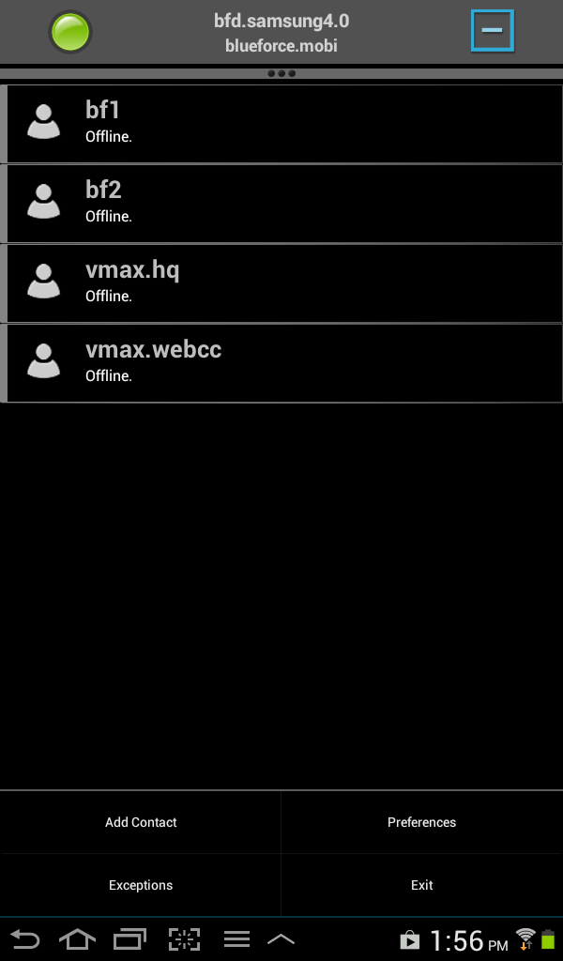
Changing XPRES in BTAC
1 - From the BTAC Home Page SELECT the Android Menu Icon
2 - SELECT Preferences Tab
2
1

Slide 2
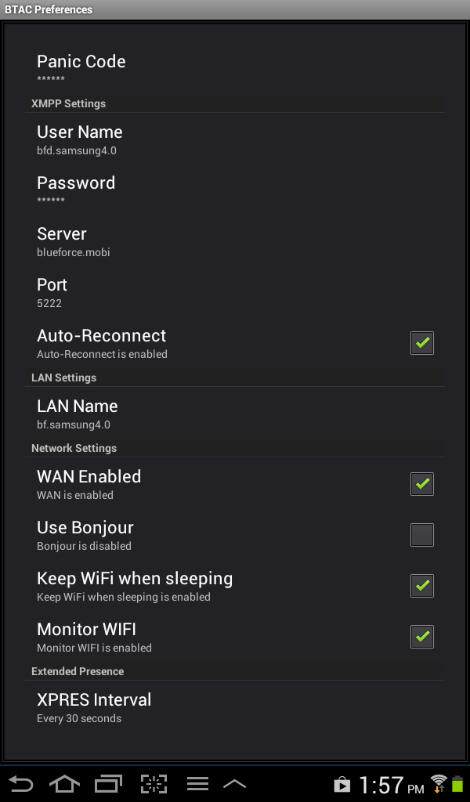
Changing XPRES in BTAC
1 – SELECT XPRES Interval
1

Slide 3
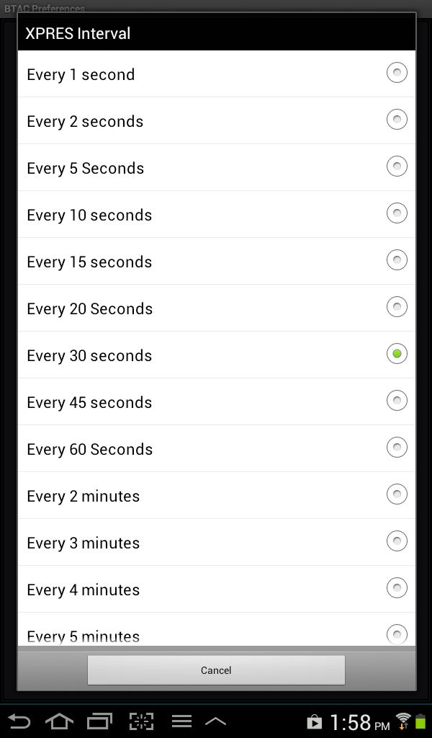
Changing XPRES in BTAC
1 – CHANGE XPRES Interval to Every 10 Seconds
RETURN to Home Page
1

